Slide 1

An introduction to GraphQL

Slide 2
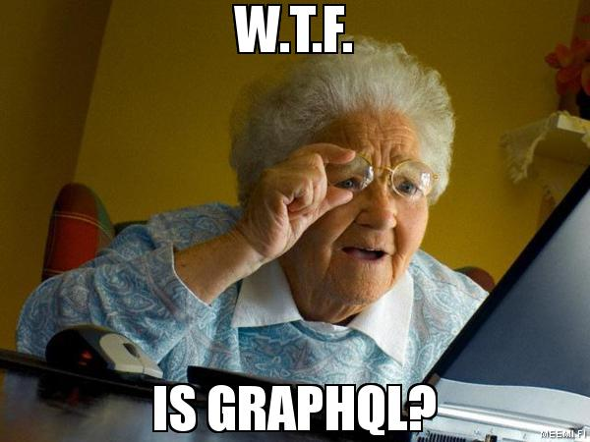

Slide 3
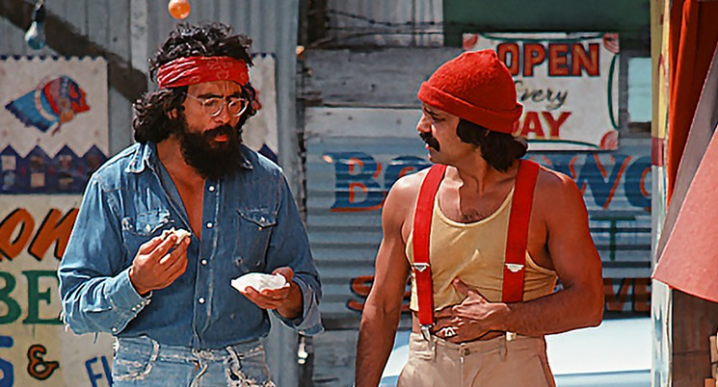
Who are we?

Slide 4

Who is this for?

Slide 5
Demo

Slide 6




Slide 8
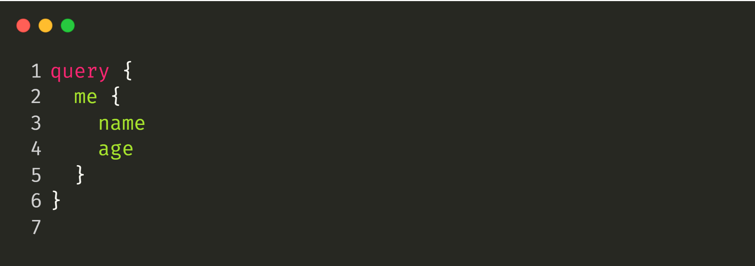
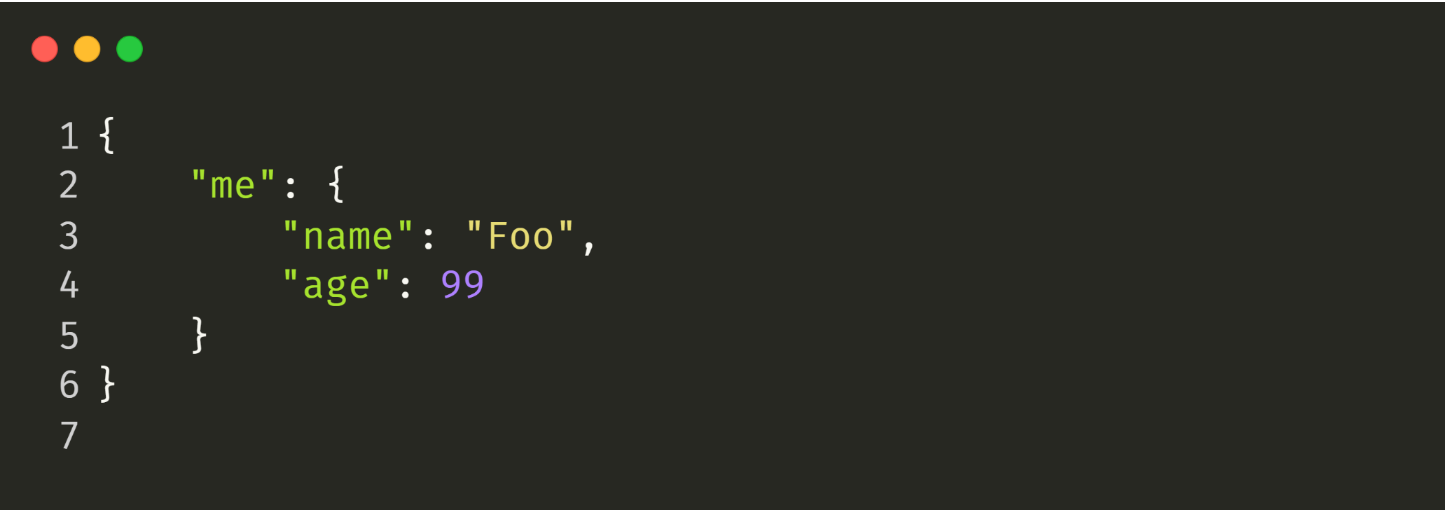

Slide 12
GET https://webservices.amazon.com/onca/xml?
Service=AWSECommerceService&
AWSAccessKeyId=mY-Sup3r-s3cr3!-k3y&
AssociateTag=12345&
Operation=ItemLookup&
ItemId=0316067938&
ResponseGroup=Reviews&
TruncateReviewsAt=256&
IncludeReviewsSummary=False&
Version=2013-08-01&
Timestamp=[YYYY-MM-DDThh:mm:ssZ]&
Signature=[Request Signature]

Slide 13
What is GraphQL?

Slide 14
GraphQL
One Endpoint
No over- or under-fetching
Simplicity
Real-time
Predictability
No versioning
One Request
Type System
Documentation

Slide 15
Demo

Slide 16


Slide 17
What GraphQL is not
Graph database query language
Solution for binary streams
Facebooks version of OData
Bound to a specific data source
Limited to HTTP
Limited to the JavaScript world
A good solution for a health check endpoint.

Slide 18
Write | Mutation | PUT, POST, PATCH DELETE
Read | Query | GET
 |  | PUT, POST, PATCH DELETE
Events | Subscriptions | N/A
Operation | GraphQL | REST

Slide 19
Challenges with GraphQL
Fetching data in a consistent way throughout the graph.
Scaling a single graph to multiple projects.
Estimating the performance impact of requests.

Slide 20
Demo

Slide 21
N+1, Filters Paging

Slide 22
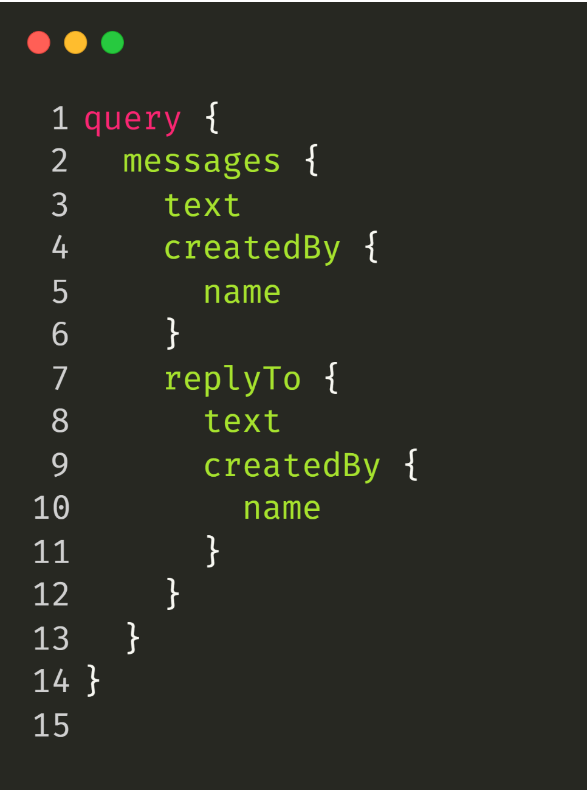

Slide 23


Slide 24
DB
Resolver
Resolver
Resolver
Resolver
DataLoader
Resolver
Resolver
Cache
Resolver
Resolver
Resolver
Resolver
Resolver

Slide 25
Demo

Slide 26
Let`s scale!

Slide 27
High Bandwidth Usage
GraphQL Client
{
"query" : <query>
}
GraphQL Server

Slide 28
Unrestricted Query Execution
GraphQL Client
{
"query" : <query>
}
GraphQL Server

Slide 29
Low Bandwidth Usage
GraphQL Client
{
“id” : “W5IYenw==”
}
GraphQL Server
Middleware

Slide 30
Restricted Query Execution
GraphQL Client
{
“id” : “W5IYenw==”
}
GraphQL Server
Middleware

Slide 31
Demo

Slide 32
Questions?

Slide 33






https://github.com/chillicream
https://swisslife-oss.github.io
https://hotchocolate.io
opensource@swisslife.ch
@chilli_cream
@swisslife_oss
https://hotchocolategraphql.slack.com
https://swisslife-oss.slack.com

